Slide 1
Week 4 (26-Jan to 1-Feb) Austin Stecklein
Goal/Task | % Done | Hours (Act.)
Finish stepper motor drivers | 100 | 4
Get database framework | 50 | 3
Investigate hardware | 50 | 6
Hours on task during the week (On track ≥ 13 / wk) | 13
Total hours on task so far this semester (On track ≥ 49 hrs) | 43

Slide 2
Progress made during the week (Log) (What I did)
Software stepper drivers are complete
Database framework is moving along
Ordered another beagle bone to replace broken hardware

Slide 3
Difficulties encountered during the week (What I did not do and why)
Blowing up the hardware

Slide 4
Goals for this coming week (Ones that move the project forward the most)
Goal/Task | Stop Date (Est.) | Hours (Est.)
Finish investigating hardware | 2/10/2021 | 4
Finish database | 2/10/2021 | 4
Help with GUI | 2/10/2021 | 6
Estimated time needed to work on goals for this coming week (typ. 13 hrs) | 14

Slide 5
Week 4 (26-Jan to 1-Feb) Colby Hatton
Goal/Task | % Done | Hours (Act.)
Finish Schematic | 70 | 6
Finish PCB | 5 | 1
Part/Research
Hours on task during the week (On track ≥ 13 / wk)
Total hours on task so far this semester (On track ≥ 49 hrs)

Slide 6
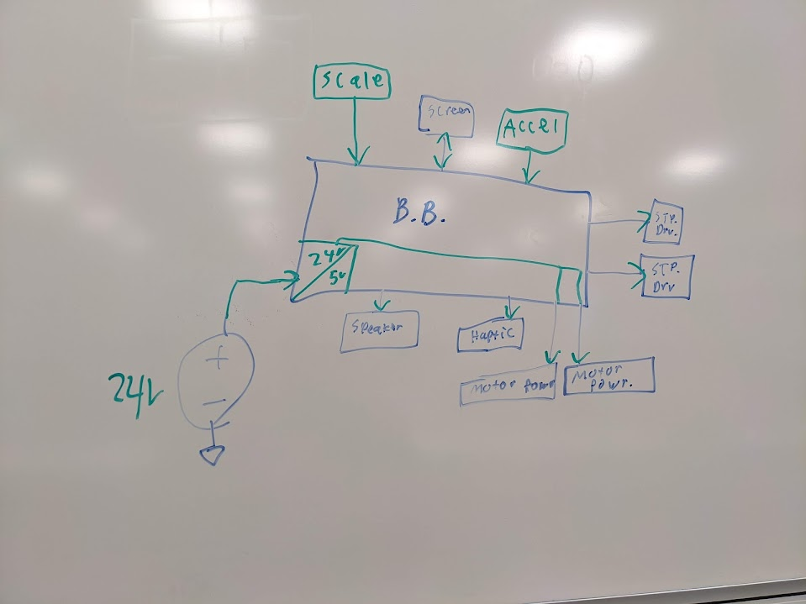
Progress made during the week (Log) (What I did)
Found and applied parts to Schematic (Mostly connectors)
Researched Memory Module
Attempted to fix BeagleBoard

Slide 7
Difficulties encountered during the week (What I did not do and why)
Assign lines to pins
Physical Work with the BeagleBoard

Slide 8
Goals for this coming week (Ones that move the project forward the most)
Goal/Task | Stop Date (Est.) | Hours (Est.)
Finish Schematic |  | 4
Begin Layout |  | 8
Estimated time needed to work on goals for this coming week (typ. 13 hrs)

Slide 9
How can we help you achieve your goals?
Part Acquisition
Line Assignments

Slide 10
Week 4 (26-Jan to 2-Feb) Dale Andreoli
Goal/Task | % Done | Hours (Act.)
Collaborate with team on UI design and implementation | 100 | 2
Research open source projects to save time creating GUI modules from scratch | 50 | 3
Research other potential libraries to use instead of tkinter | 50 | 1
Implement GUI modules | 15 | 6
Project Objective / Mission Statements
Power Scale Dispenser:
Design, build, and test the electronics for the dispenser with a touch screen display and controlling two stepper motors by April 6, 2021 with a prototyping budget of $1000 USD and for less than 600 people-hours.
Hours on task during the week | 12
Total hours on task so far this semester | 42

Slide 11
Progress made during the week (Log) (What I did)
Collaborated with team on UI design and implementation
Researched libraries and projects to save time creating GUI modules from scratch
Researched other potential libraries to use instead of tkinter

Slide 12
Difficulties encountered during the week (What I did not do and why)
We now have a nice clear plan for what the UI needs

Slide 13
Goals for this coming week (Ones that move the project forward the most)
Goal/Task | Stop Date (Est.) | Hours (Est.)
Find or design a touch keyboard module to be used in the GUI | Feb 9th | 9
Collaborate with Jonathan and Austin on GUI implementation |  | 3
Estimated time needed to work on goals for this coming week | 12

Slide 14
Week 4 (26-Jan to 1-Feb) John Stinger
Goal/Task | % Done | Hours (Act.)
Board Design | 15% | 4
Component Selection | 70% | 4
Team Meetings and Discussions |  | 3
Hours on task during the week (On track ≥ 13 / wk) | 11
Total hours on task so far this semester (On track ≥ 49 hrs) | 39

Slide 15
Progress made during the week (Log) (What I did)
For example: Resources found (links, manuals), Designs created, Decisions made and corresponding rational, Photos of prototype progress, etc.
Continued the board design process
Selected components for the I/O connections
Ordered the components

Slide 16
Difficulties encountered during the week (What I did not do and why)
Certain components were unorderable

Slide 17
Goals for this coming week (Ones that move the project forward the most)
Goal/Task | Stop Date (Est.) | Hours (Est.)
Continue to work on the board schematic |  | 6
Continue to work on the board layout |  | 6
Estimated time needed to work on goals for this coming week (typ. 13 hrs) | 12

Slide 18
How can we help you achieve your goals?
Is the motor drivers going to be integrated into the main board?

Slide 19
Week 4 (26-Jan to 1-Feb) Jonathan Phillips
Goal/Task | % Done | Hours (Act.)
Front End | N/A | 11
Hours on task during the week (On track ≥ 13 / wk) | 11
Total hours on task so far this semester (On track ≥ 49 hrs) | 40

Slide 20
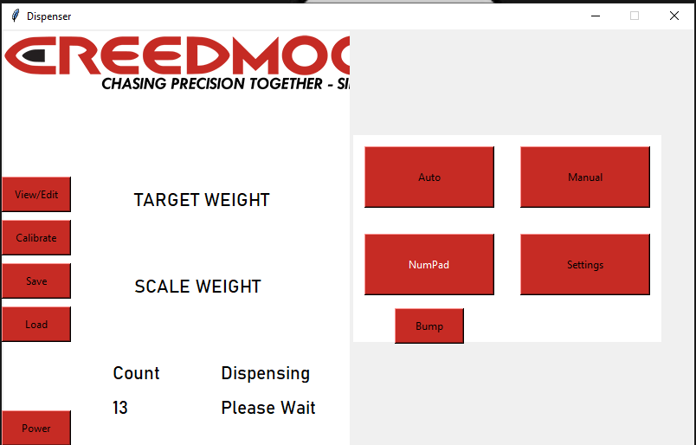
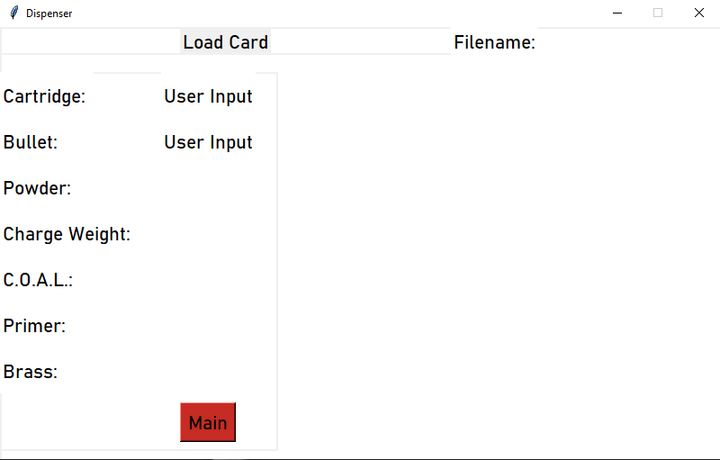
Progress made during the week (Log) (What I did)

Slide 21
Difficulties encountered during the week (What I did not do and why)
The buttons cannot be modified that much using this python library,
However, the buttons can be made using images instead

Slide 22
Goals for this coming week (Ones that move the project forward the most)
Goal/Task | Stop Date (Est.) | Hours (Est.)
Front End | 4/1/22 | 13
Estimated time needed to work on goals for this coming week (typ. 13 hrs) | 13

Slide 23
How can we help you achieve your goals?
Refining UI Design and Layout

